Slide 1
Six Sigma Green Belt Certification Exam preparation
Presented by: Tanmoy Das
Certified Six Sigma Green Belt from ASQ

Slide 2
7 Tools of Quality

Slide 3
7 Tools of Quality
Cause-and-effect diagram (aka the fishbone diagram)
Check sheet.
Control chart.
Histogram.
Pareto chart.
Scatter diagram.
Stratification (alternately, flow chart or run chart)

Slide 4
Exploratory Data Analysis

Slide 5
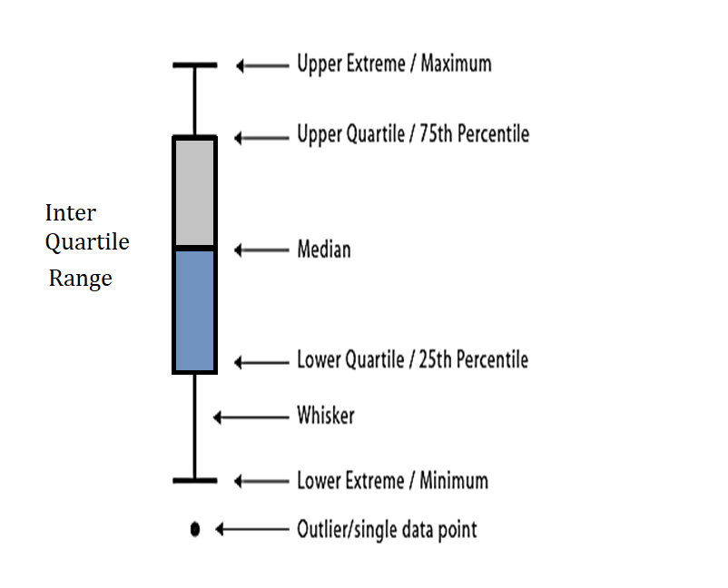
Box Plot
Maximum
Q3
A box plot is a way of graphically depicting groups of numerical data through their quartiles
Median
Q1
Minimum
Outlier: A datapoint outside of major datapoints, tell lies about the dataset

Slide 6
Box Plot
Application:
Compare a data with other datapoints. E.g. a student’s performance compared to all students in that class
Outlier Detection

